Slide 1

Seoul Bike Sharing Demand Prediction
A Machine Learning Journey Through People, Patterns, and Planning
Dataset Link
Video Link
Presented by: Padmasree Sappa Course: DS 861 Professor: Eghbal Rashidi

Slide 2

The Real-World Problem
Seoul’s bike-sharing system is smart, scalable — but suffers from demand unpredictability
On busy mornings, bikes run out before 9 AM; on quiet days, docks stay full for hours
Operators are left guessing — relying on instinct instead of insight
This leads to:
Wasted reallocation efforts
Poor user satisfaction
Idle bikes in low-demand zones
Empty stations during peak hours
A forecasting model could shift the system from reactive to proactive
If demand could be predicted, decisions could be planned — not just patched

Slide 3

The Question That Sparked It All
What if this wasn’t noise, but routine?
What if we could find patterns in the way people ride — just by looking at weather and time?
“Can we predict Seoul’s hourly bike rentals using just weather and calendar data?”

Slide 4
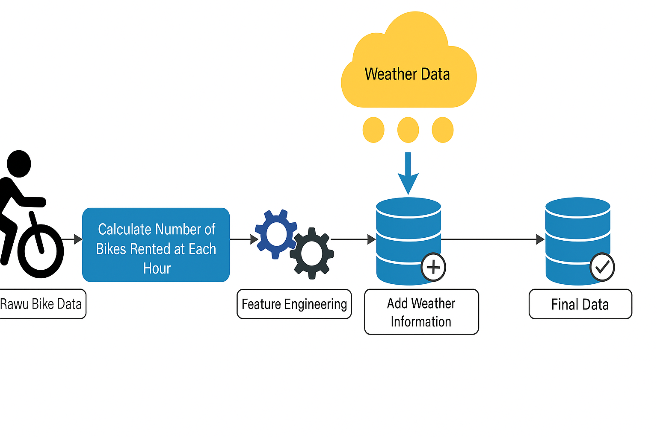
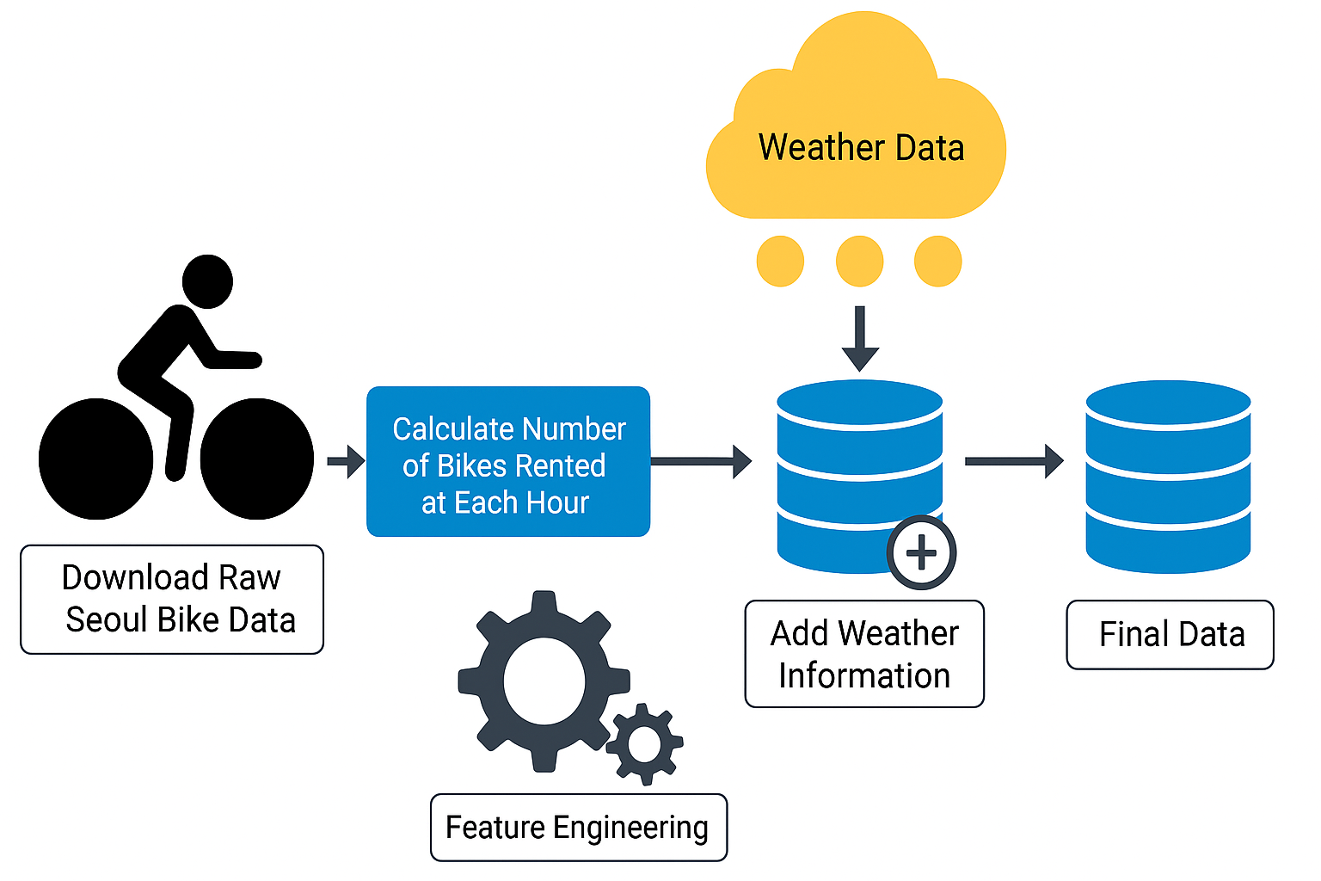
My Goal and Design Choice
Goal: Build a predictive model that estimates hourly bike rentals based on external features.
Design Choice: Use regression to predict exact rental counts instead of classifying demand levels.
Framework: CRISP-DM methodology to structure each phase — from understanding the business context to final model evaluation.

Slide 5
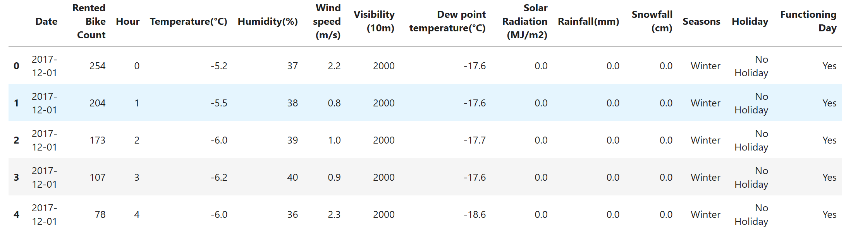
The Dataset
Loaded a public dataset containing hourly bike rental records in Seoul for afull year (8,760 rows).
Includes a mix of weather, calendar, and system status features.
Target variable:
Rented Bike Count (bikes rented perhour).
Feature groups:
Temporal: Date, Hour, Holiday,Functioning Day, Season
Weather: Temperature,Humidity, Wind Speed,Visibility, Rainfall, Snowfall,SolarRadiation, Dew PointTemp

Slide 6

Phase 1 - Data Understanding
Goal:
Explore and clean the dataset to uncover patterns that influence bike rental demand.
Highlights:
Loaded and inspected 8,760 hourly records
Created time-based features (e.g., Hour, Is_Weekend)
Found ~20% outliers using IQR
Discovered clear trends: rental peaks during commute hours, drops on holidays and winter days

Slide 7
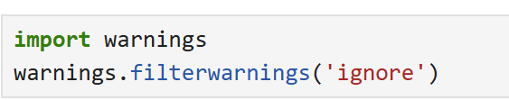
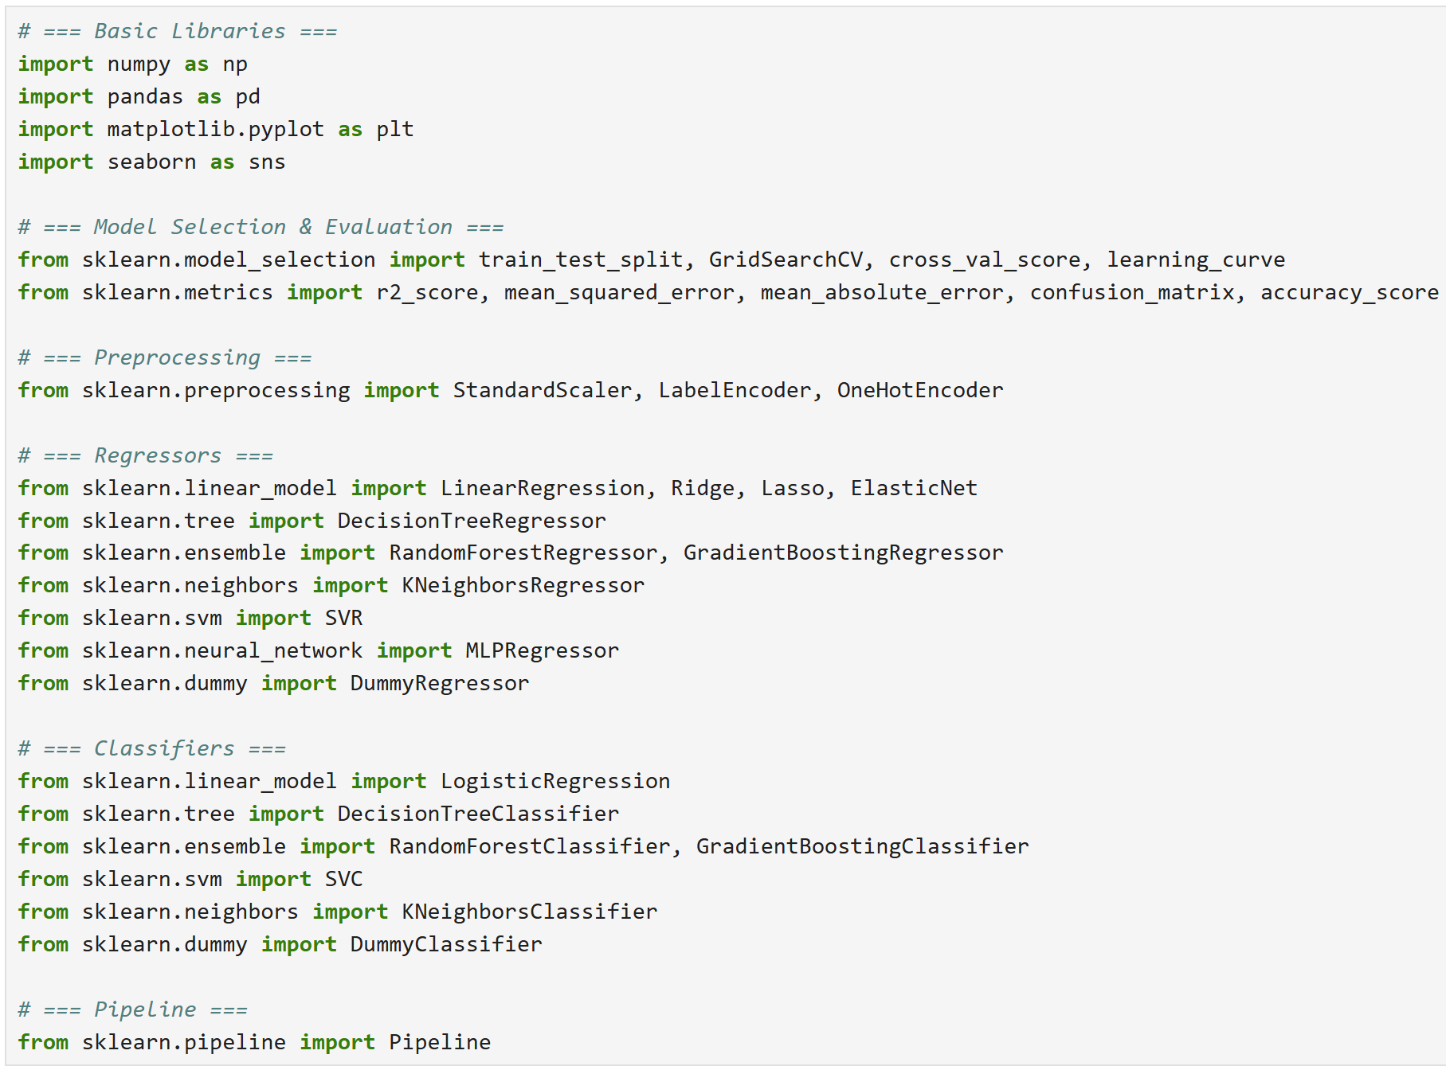
Importing Tools
Before diving into the data, it’s essential to import the required Python libraries. These provide the foundation for analysis, modeling, and visualization throughout the project.
pandas and numpy for data manipulation
matplotlib.pyplot and seaborn for visualizations
sklearn modules for preprocessing, model building, and evaluation
Warnings suppressed for clean outputs

Slide 8
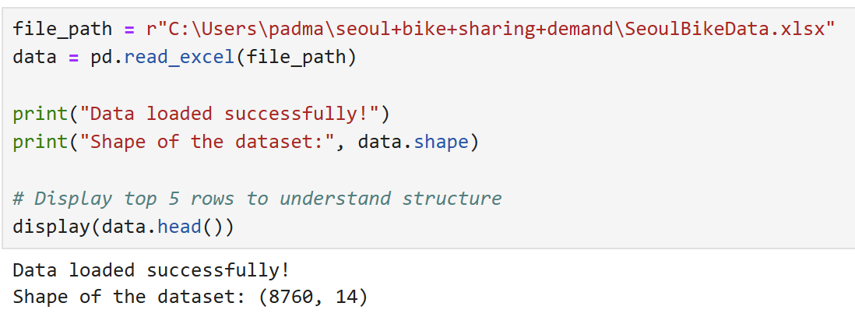
Loading the Dataset
The dataset used contains hourly records of bike rentals in Seoul, along with weather, calendar, and system status features.
Loaded from an Excel file
Shape: 8,760 rows × 14 columns
This matches 365 days × 24 hours
Data appeared complete and clean
I loaded the Seoul Bike Sharing dataset from my local drive using pandas.read_excel to kick things off.

Slide 9
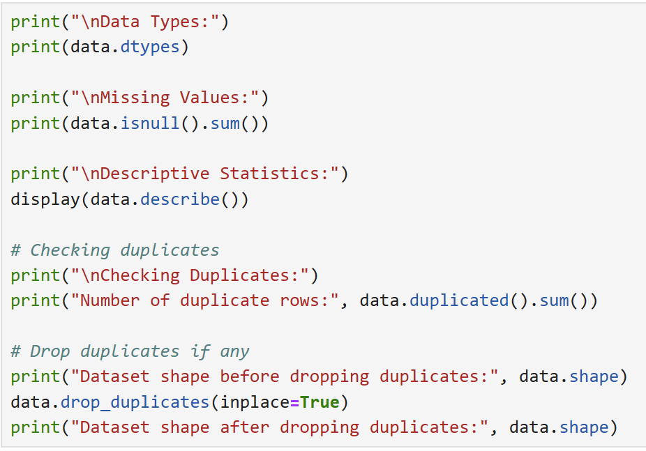
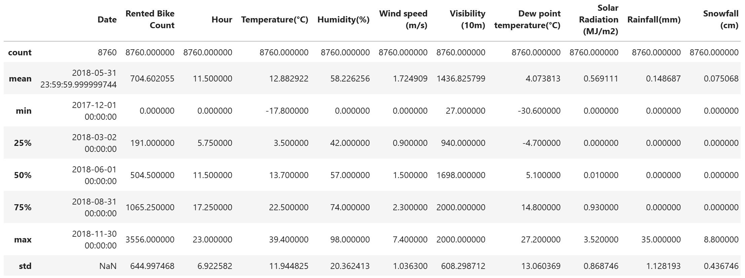
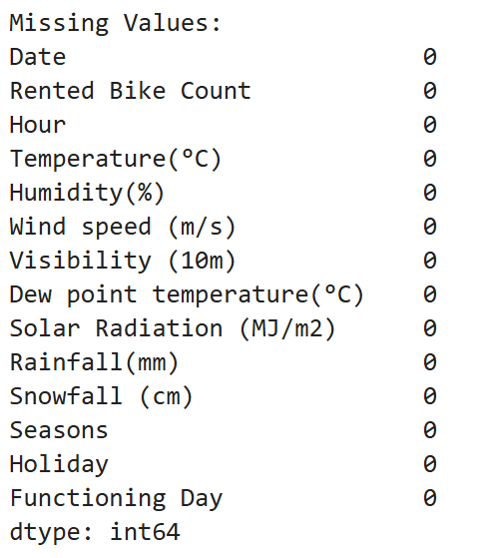
Initial Exploration
Initial inspection ensures the data structure is sound and ready for further processing.
All columns had appropriate data types
No missing values or duplicates
Descriptive stats showed large variability in key features (e.g. bike counts, temperature)

Slide 10
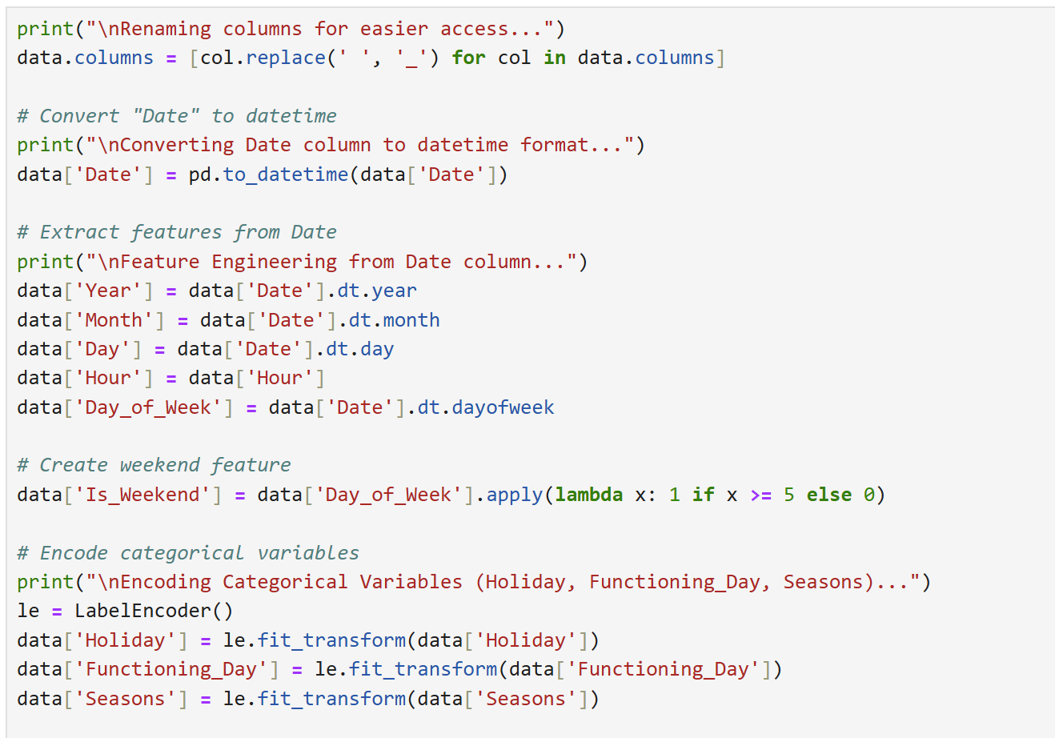
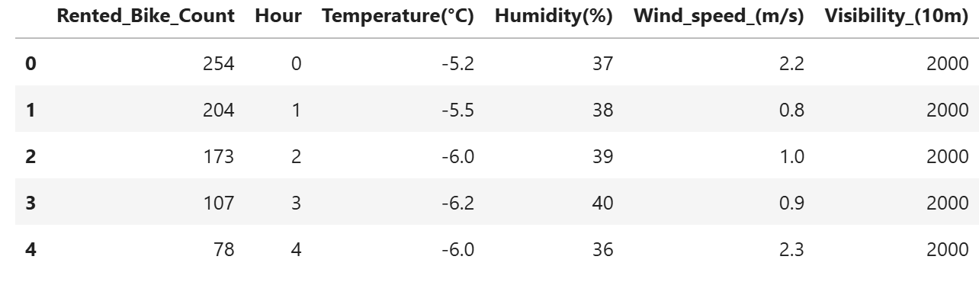
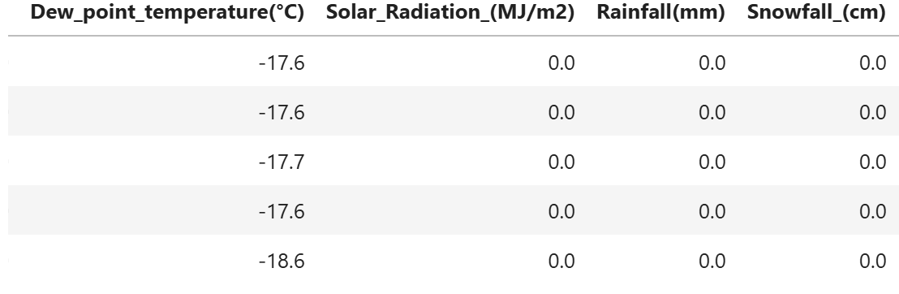
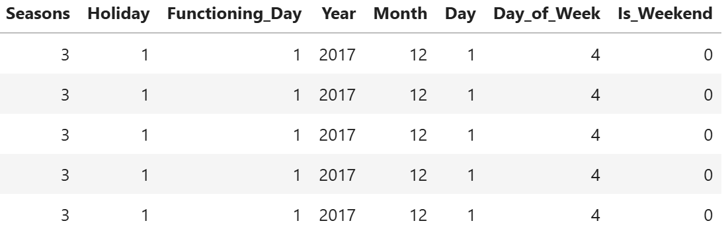
Cleaning & Feature Engineering
To make data ML-ready, several transformations were applied:
Replaced spaces with underscores in column names
Extracted time features: Day_of_Week, Is_Weekend
Encoded Holiday, Functioning_Day, Seasons into numeric
Dropped original Date column after extraction
This step created powerful temporal signals to model human behavior patterns.

Slide 11
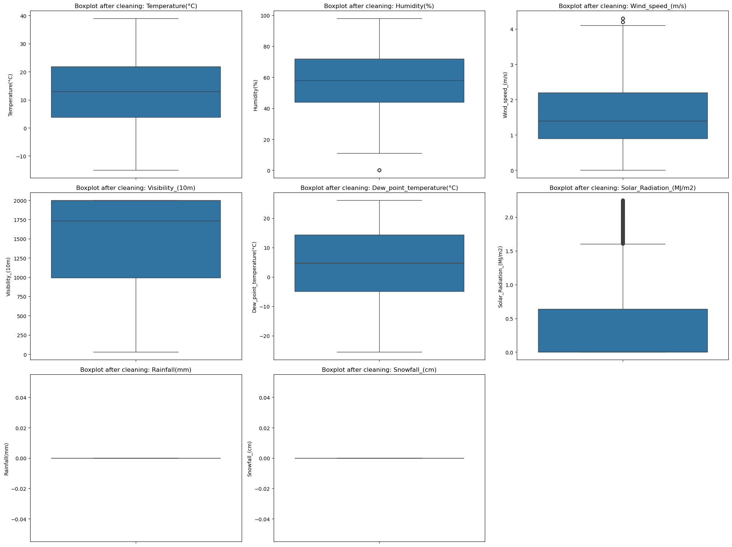
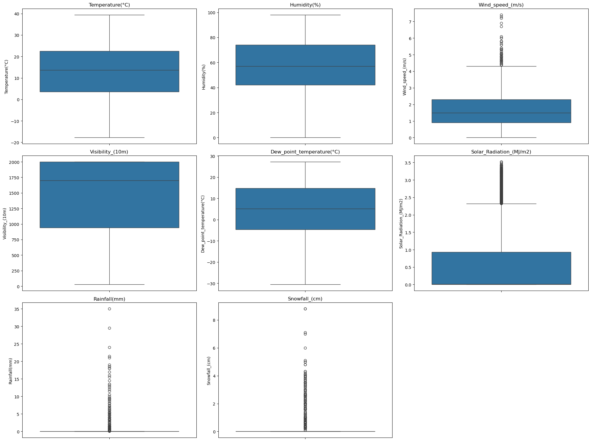
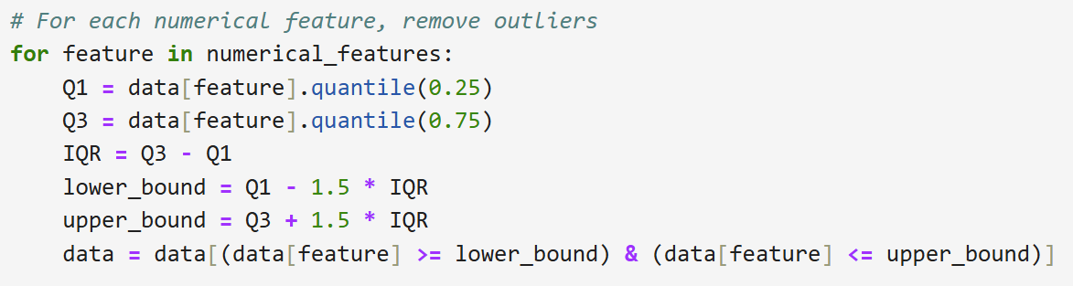
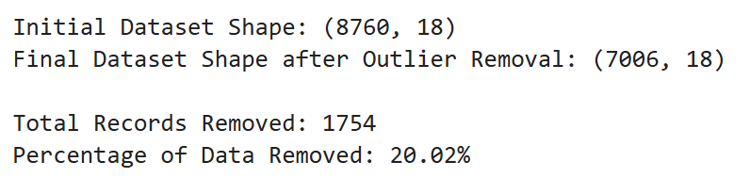
Outlier Detection
Outliers in weather data can distort model learning. Using the IQR method, extreme values were removed from:
Temperature, Humidity, Wind Speed, Visibility
Solar Radiation, Rainfall, Snowfall
~20% of rows removed, focusing on rare extreme events not representative of typical behavior.
Not Removing Outliers

Slide 12
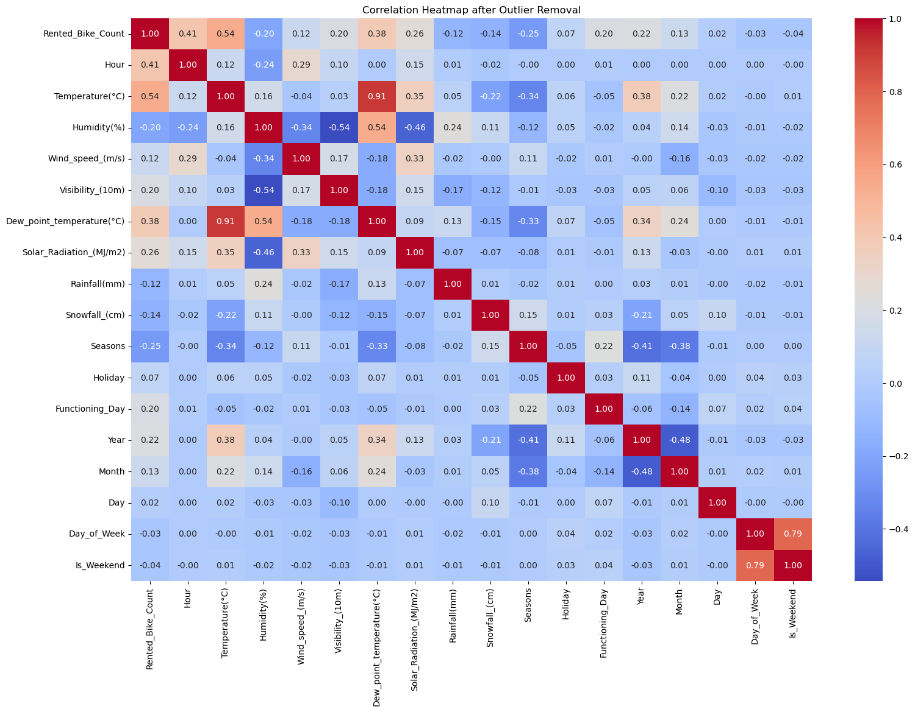
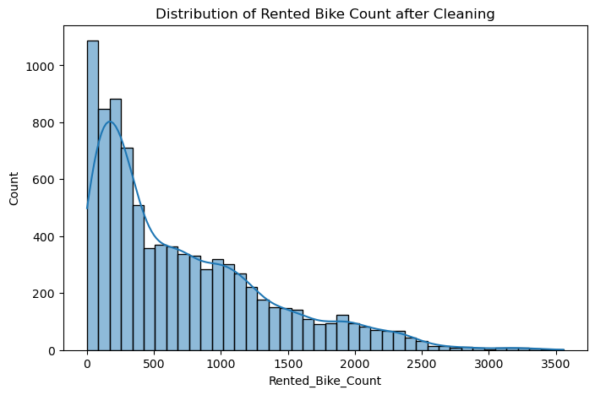
Correlation Heatmap and Distribution Plot

Slide 13
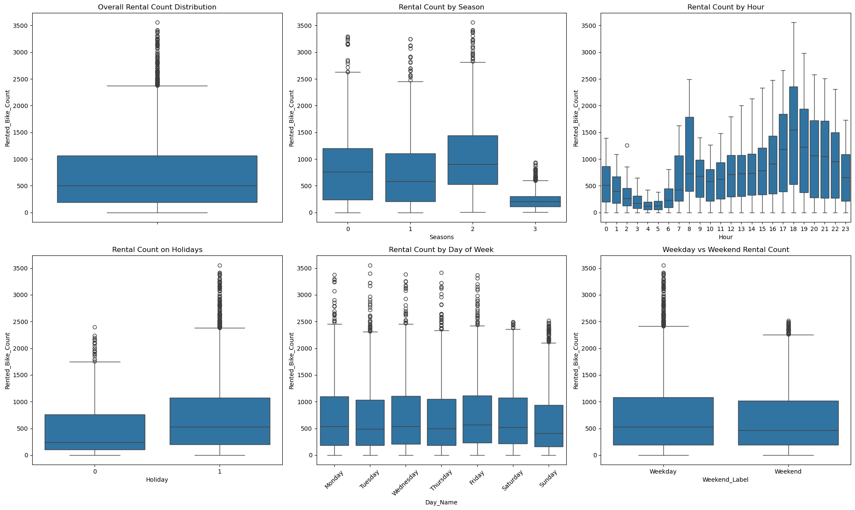
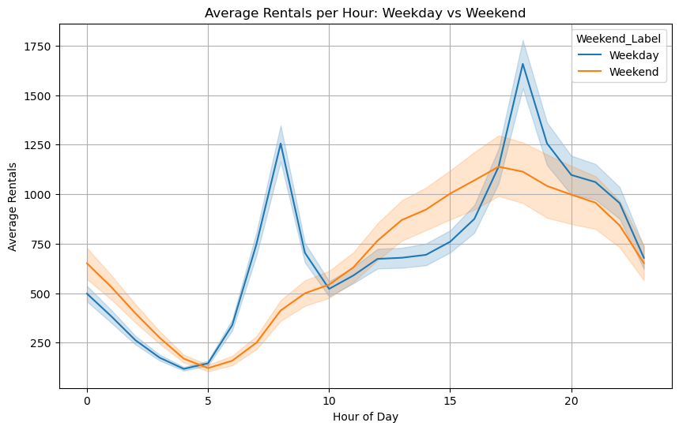
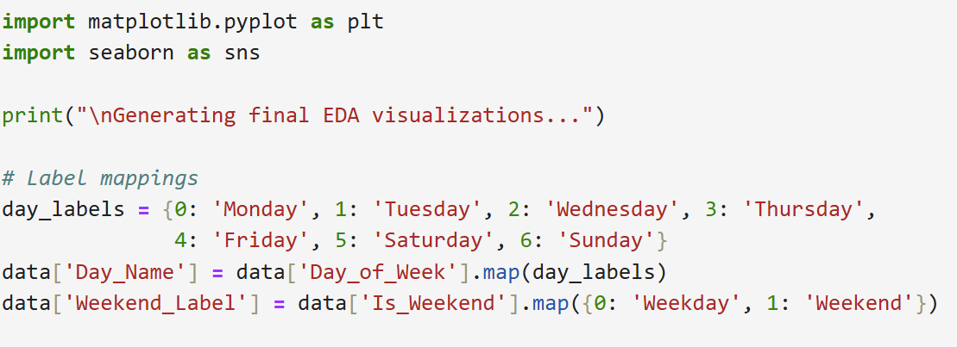
Data Analysis
EDA revealed clear temporal and weather-related patterns in rental demand:
Commute spikes: Peaks at 8 AM and 6 PM
Seasonality: Summer sees highest rentals; winter lowest
Weekends & Holidays: Lower and more variable usage
These insights confirmed feature engineering choices and guided model strategy.

Slide 14

Phase 2 – Data Prep & Modeling
Goal:
Prepare data for machine learning and build predictive models.
Highlights:
Scaled features using StandardScaler
Split into 80% training / 20% testing
Built and compared multiple regressors
Gradient Boosting achieved best performance (R² ≈ 0.92, RMSE ≈ 173)

Slide 15
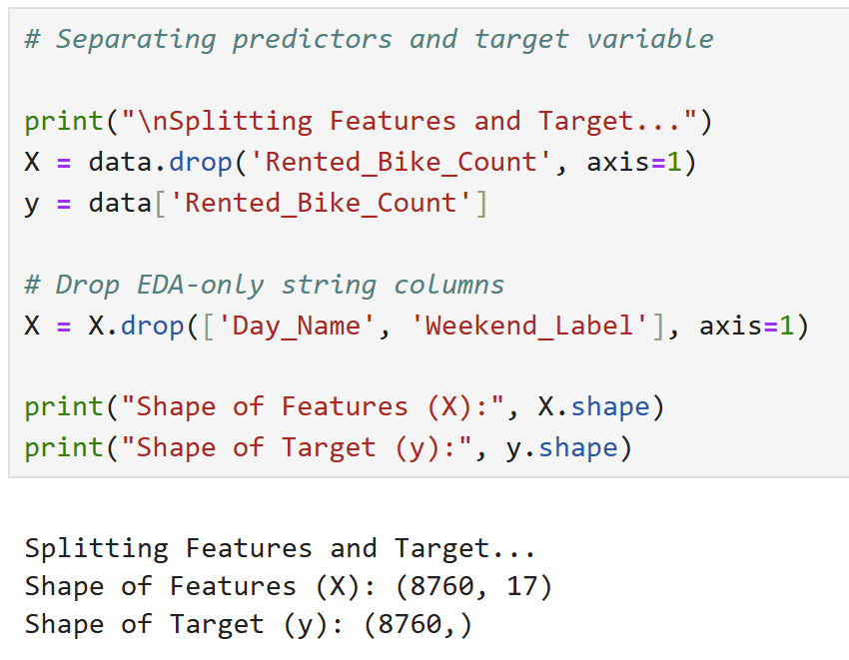
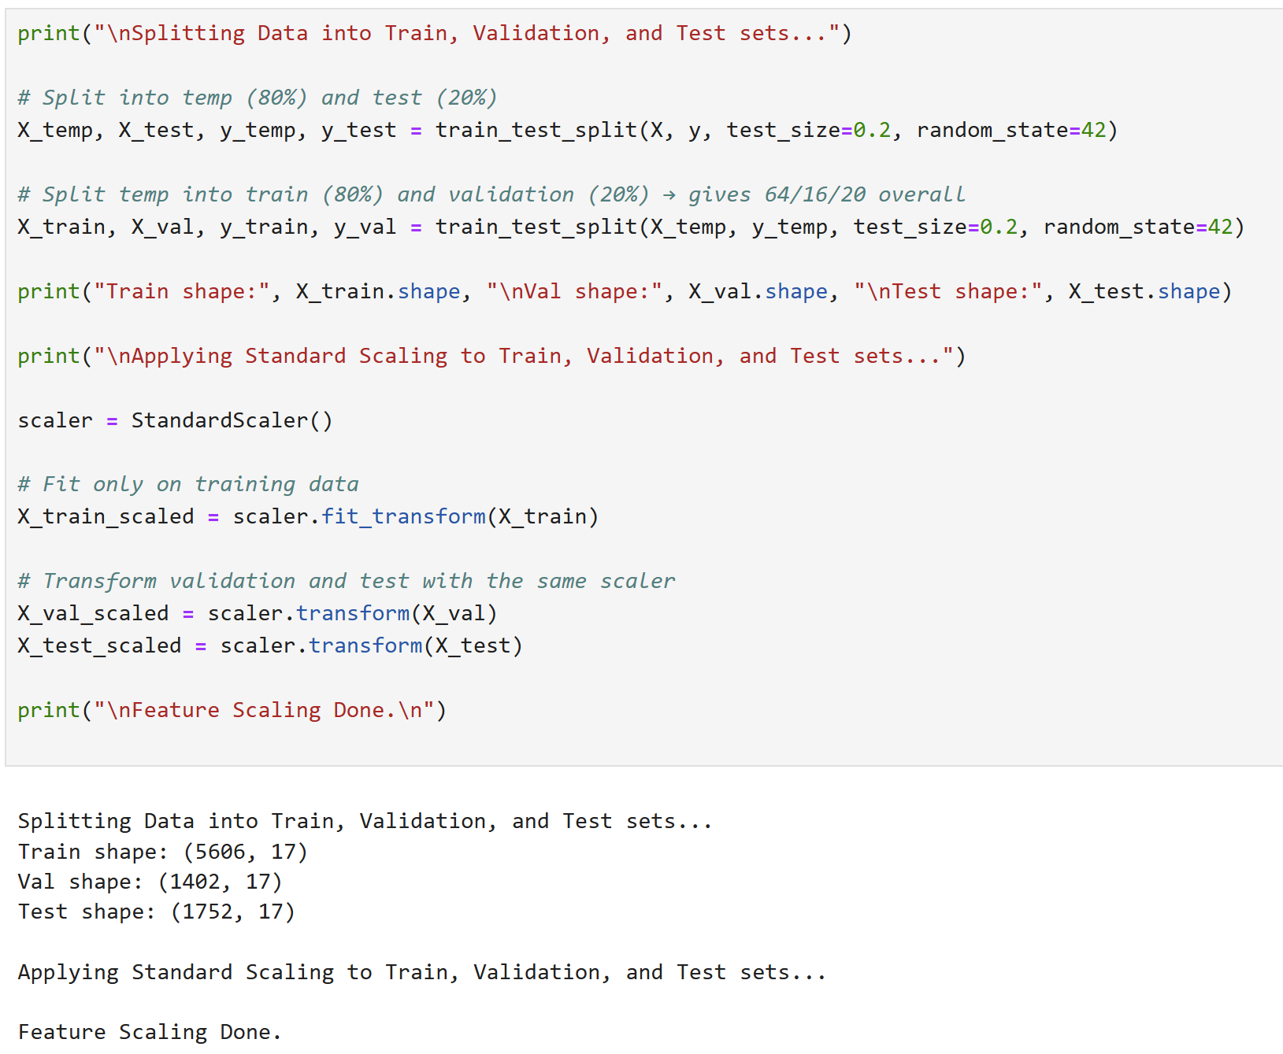
Train-Test Split & Feature Scaling
Before training any models, I prepared the data for supervised learning:
Split the data into features (X) and target (y)
Dropped helper columns like Day_Name, Weekend_Label used for visual EDA
Scaled features using StandardScaler to ensure equal importance for models that rely on distance (e.g., KNN, SVM)
To evaluate generalization, I split the dataset:
64% for training, 16% for validation, 20% for testing
Used train_test_split() with fixed random seed for reproducibility
The training set contains 5,606 records The validation set contains 1,402 records The test set contains 1,752 records
This ensures we test the model on unseen, real-world-like data.

Slide 16
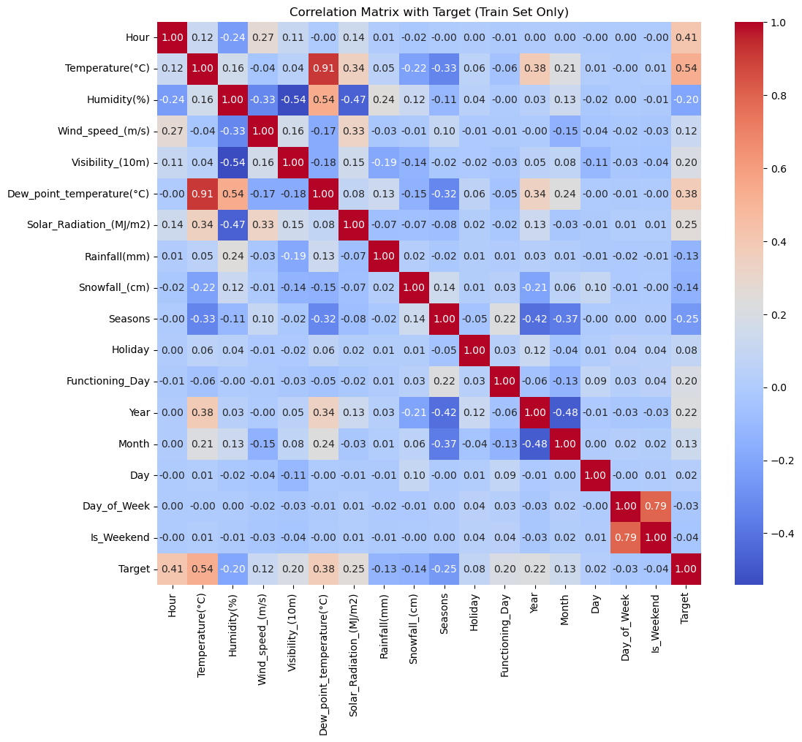
Data Leakage Check
No evidence of data leakage
The highest correlation was with Temperature(°C) at 0.54, which is reasonable and expected.
Other top correlations like Hour, Dew Point Temperature, and Solar Radiation are all logically related to bike rental behavior.
No features had near-perfect correlation with the target.
Rainfall(mm) and Snowfall(cm) returned NaN — likely due to
having zero variance (all or mostly zero values).

Slide 17
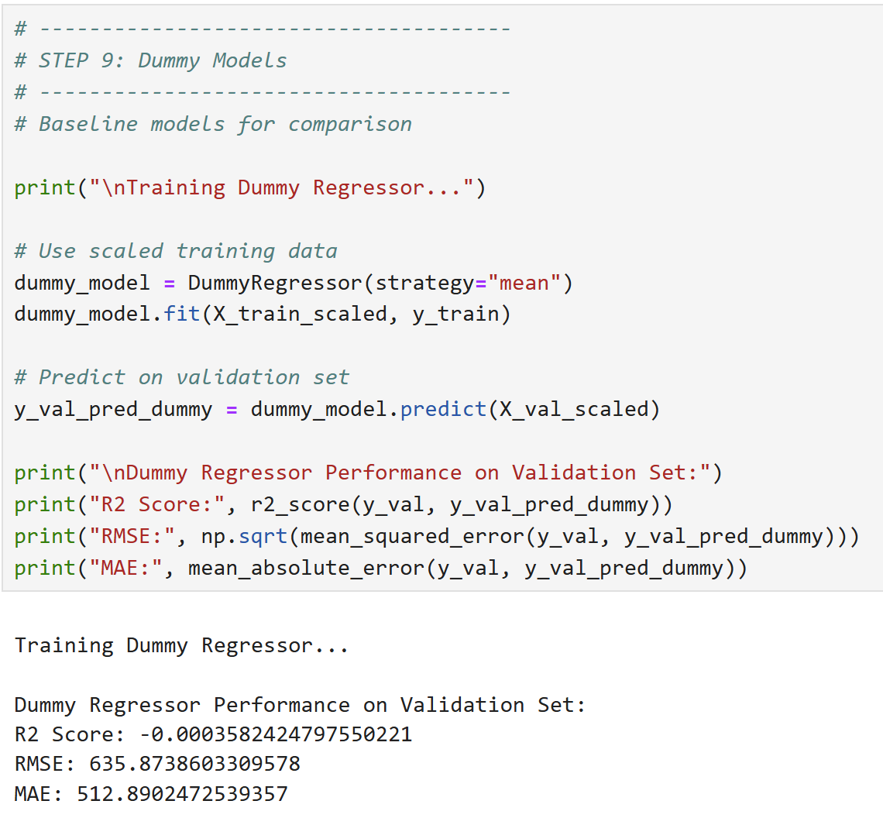
Baseline: Dummy Regressor
To assess if our future models are truly learning, I built a baseline model:
Used DummyRegressor to always predict the mean
Compared against real models later using:
R² Score
RMSE
MAE
This step ensures we aren't over-engineering the solution.

Slide 18
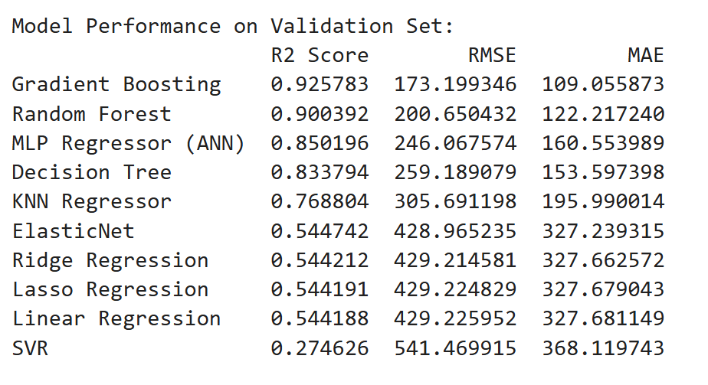
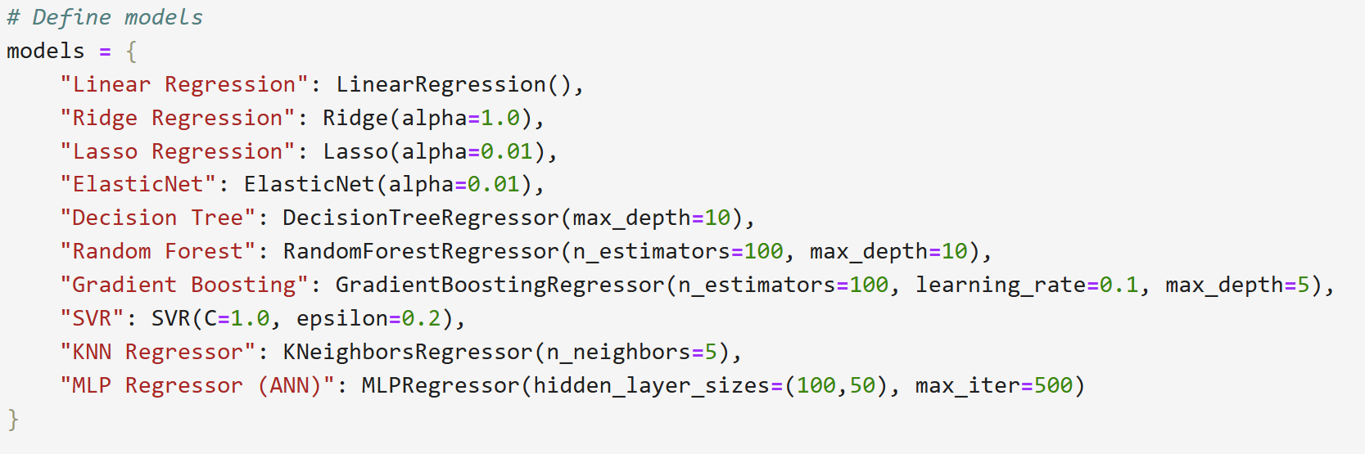
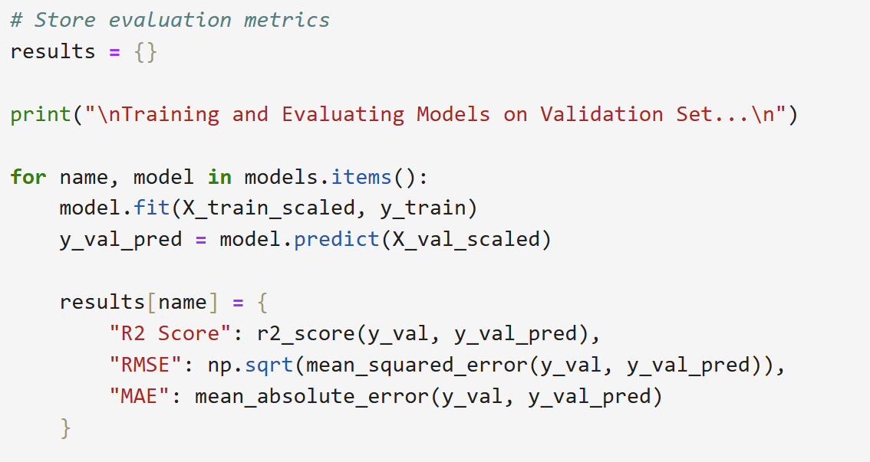
Model Training & Comparison
I trained a diverse set of regression models to predict Rented_Bike_Count. Each model was evaluated using R², RMSE, and MAE on test data.
Models included:
Linear Models: Linear Regression, Ridge, Lasso, ElasticNet
Tree-Based Models: Decision Tree, Random Forest, Gradient Boosting
Others: KNN, SVR, MLP (Neural Network)
Tree-based models (especially Gradient Boosting) performed best.

Slide 19
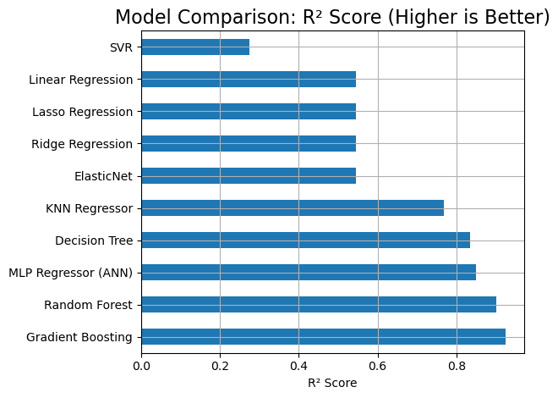
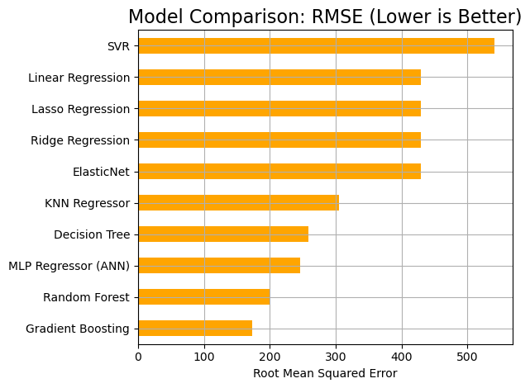
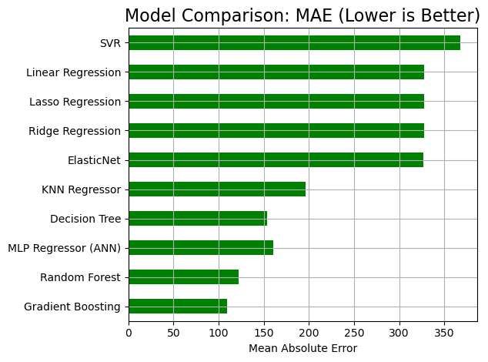
Visualizing the Results
To compare model performance visually, I plotted bar charts for each evaluation metric:
R² Score → Higher is better
RMSE & MAE → Lower is better
Gradient Boosting consistently outperformed others, achieving:
R² ≈ 0.92
RMSE ≈ 173
MAE ≈ 109

Slide 20

Phase 3 – Evaluation & Insights
Goal: Validate model performance, tune parameters, and extract business value.
Highlights:
Applied cross-validation and GridSearchCV
Analyzed residuals and feature importance
Key drivers: Hour, Temperature, Day_of_Week
Delivered accurate, interpretable model for real-time rental prediction

Slide 21
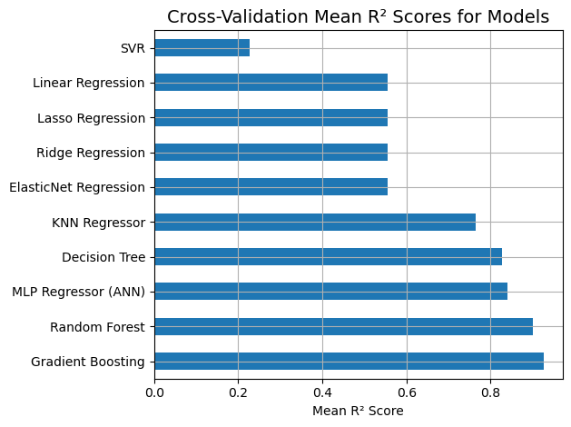
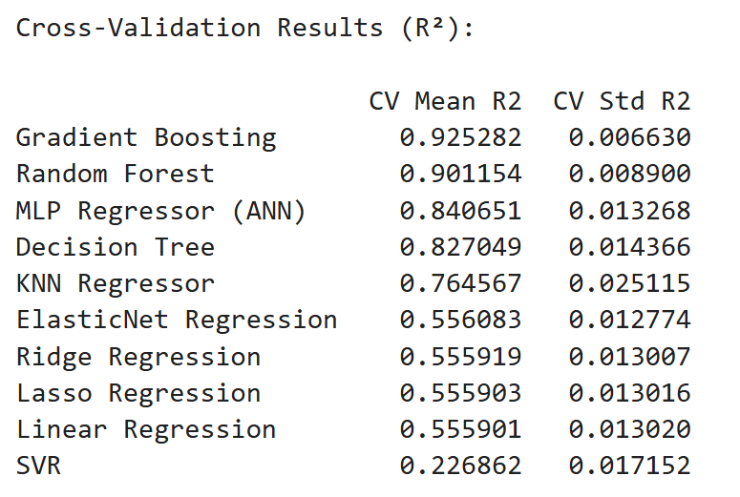
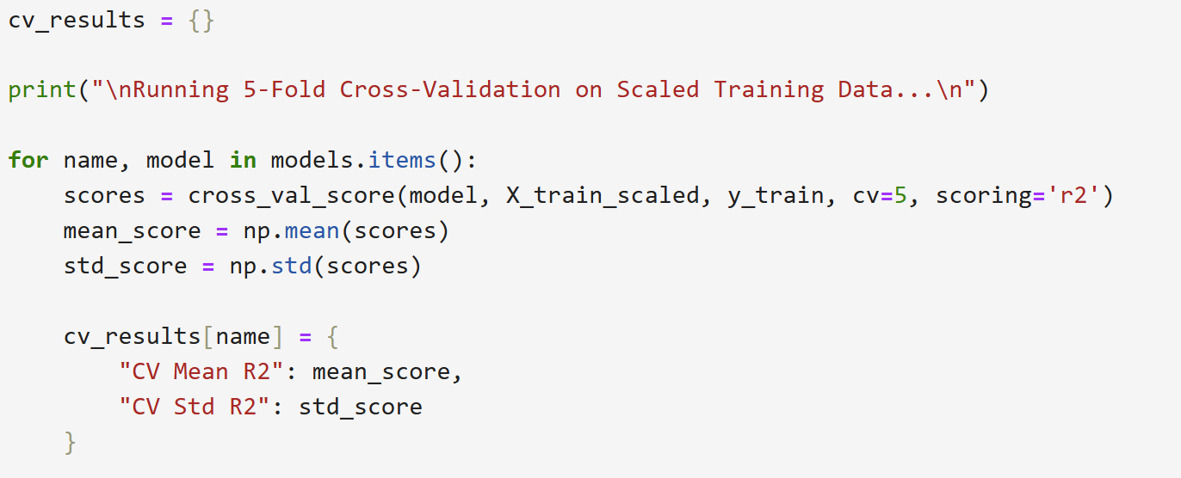
Cross-Validation
To ensure model stability across different subsets of data, I performed 5-fold cross-validation:
Prevents models from overfitting to a single split
Reports average R² Score and variance
Confirms generalization ability of top models
Gradient Boosting and Random Forest remained top performers with high mean R² and low variance.

Slide 22
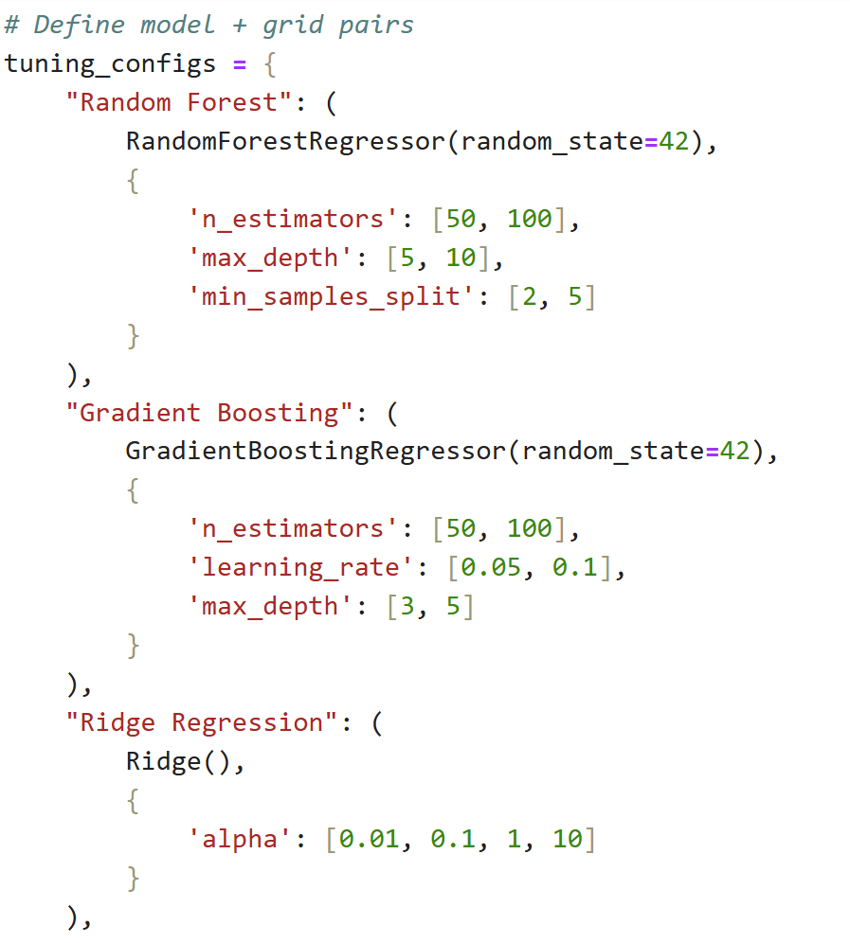
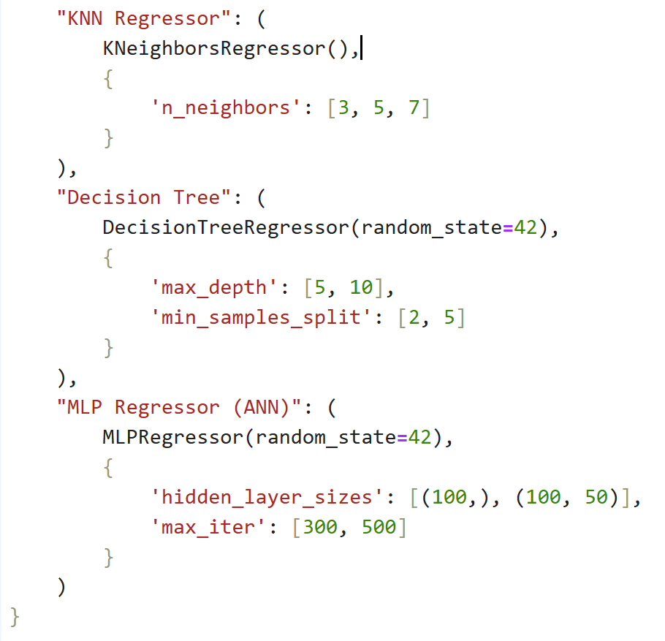
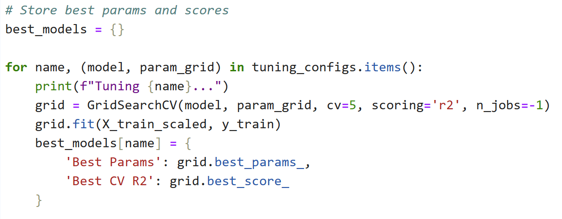
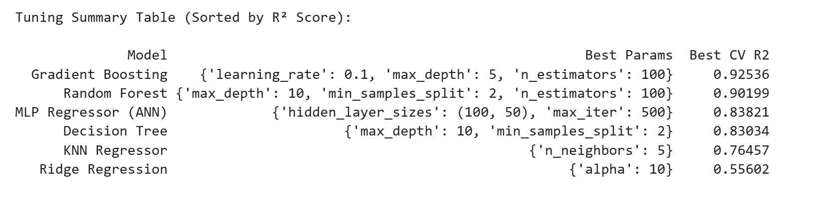
Hyperparameter Tuning
Optimize model performance by tuning hyperparameters using GridSearchCV with R² scoring and 5-fold cross-validation.
Models Tuned:
Random Forest
Gradient Boosting
Ridge Regression
K-Nearest Neighbors (KNN)
Decision Tree
MLP Regressor (Artificial Neural Network)
Evaluation Metric: Cross-validated R² score (Best CV R²)

Slide 23
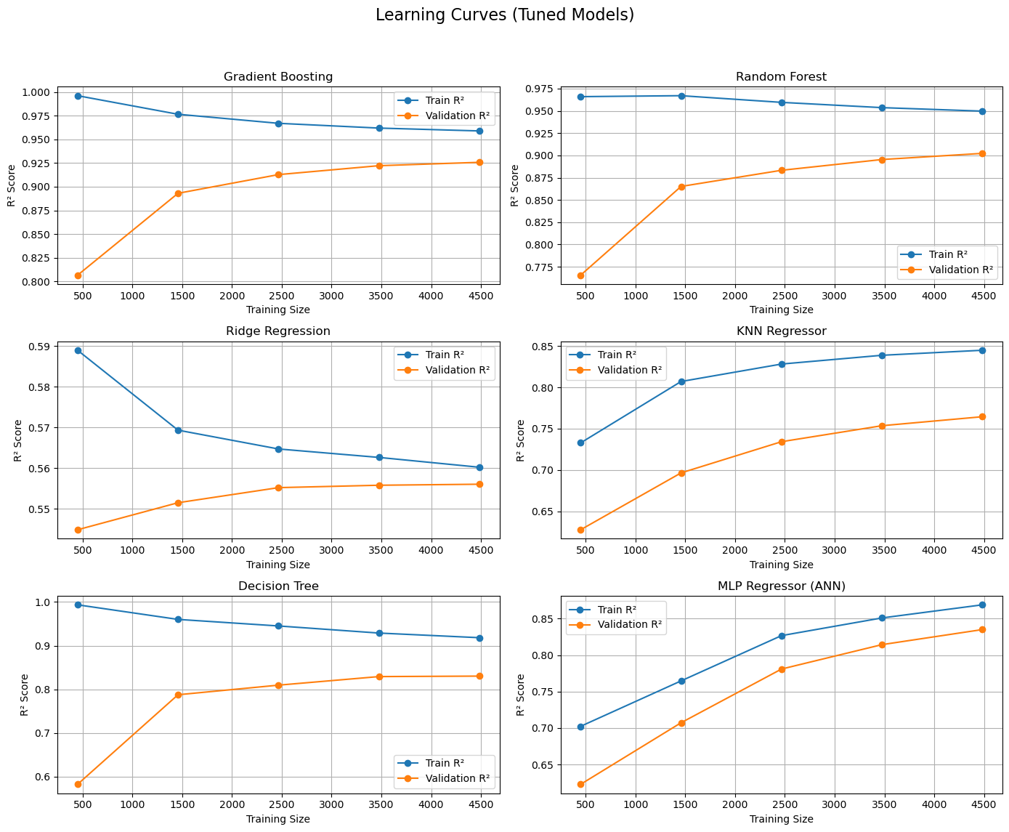

Learning Curves
To examine bias-variance trade-off, I plotted learning curves:
Showed how performance changes with more training data
Helped detect underfitting or overfitting
Gradient Boosting and Random Forest showed strong convergence and generalization.

Slide 24
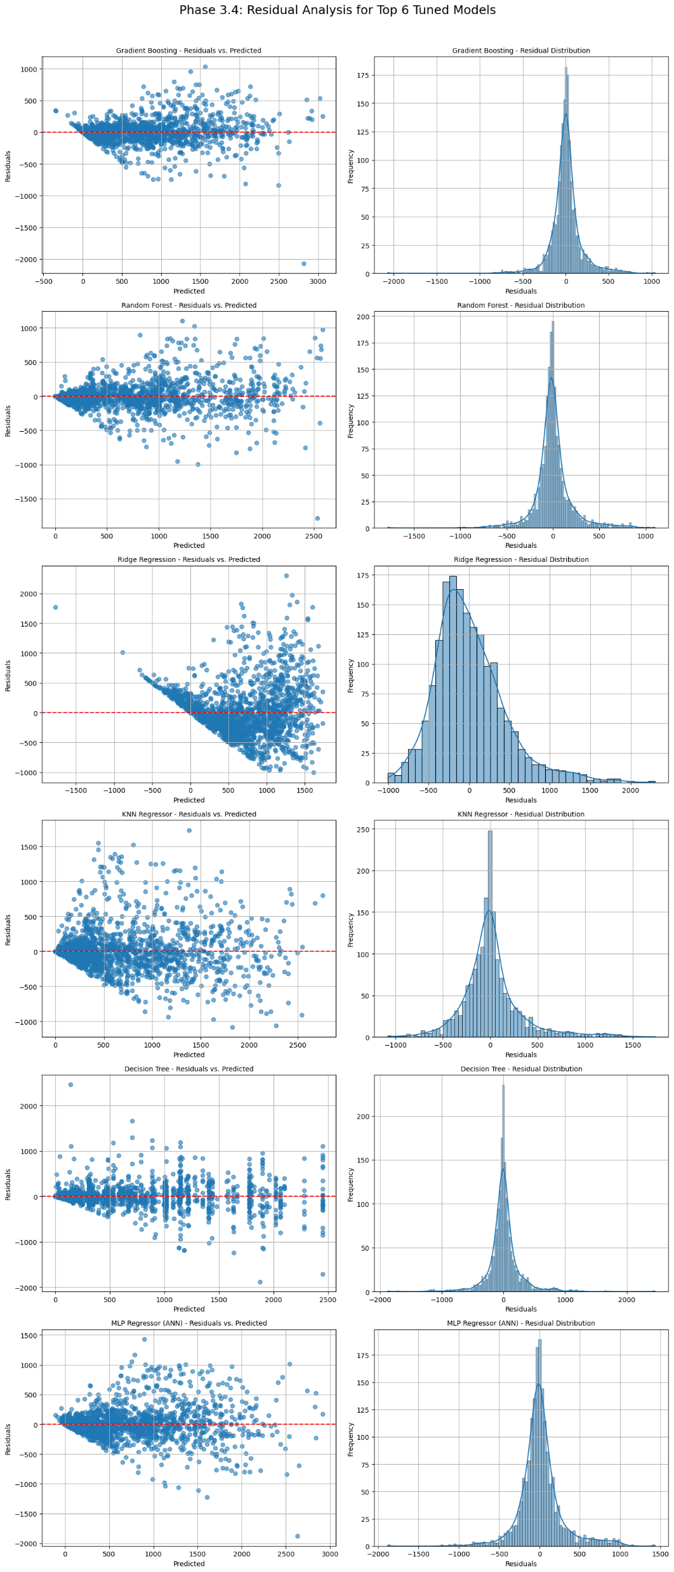
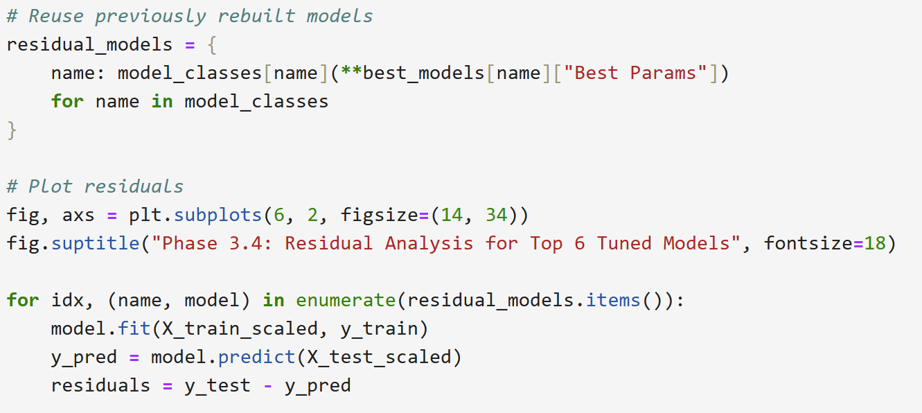
Residual Analysis
Residual plots reveal prediction errors and biases.
Good models have residuals centered around 0
Poor models show patterns or skewed residuals
Gradient Boosting had tight, symmetric residuals Ridge Regression showed wide scatter and bias

Slide 25
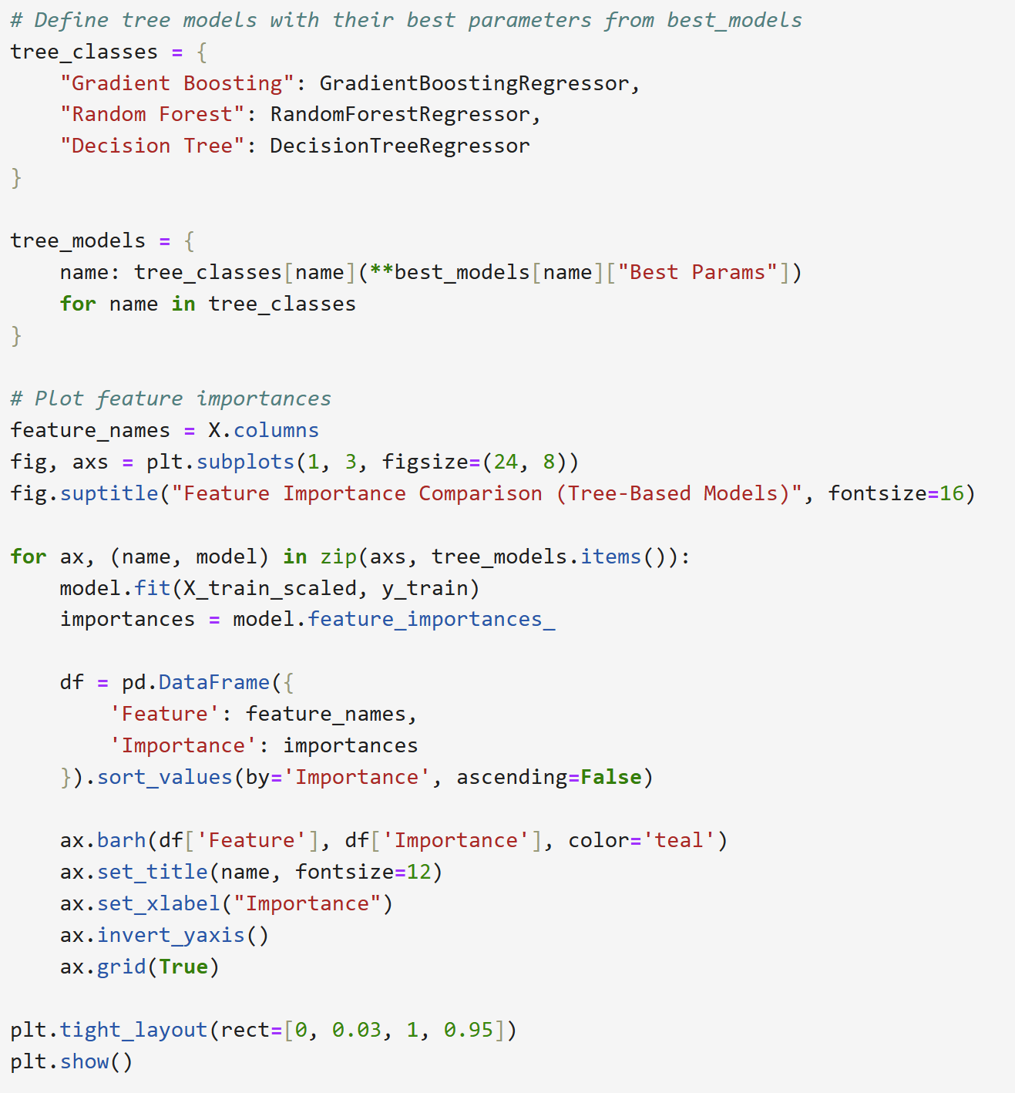
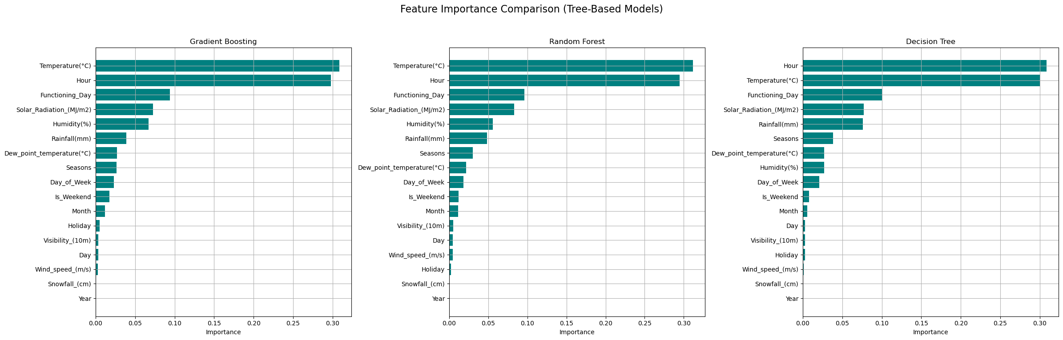
Feature Importance
Feature importance reveals what the model learns from
Hour and Temperature were most influential
Features like Rainfall and Snowfall had minimal effect
This improves explainability and supports feature reduction for lighter models.

Slide 26
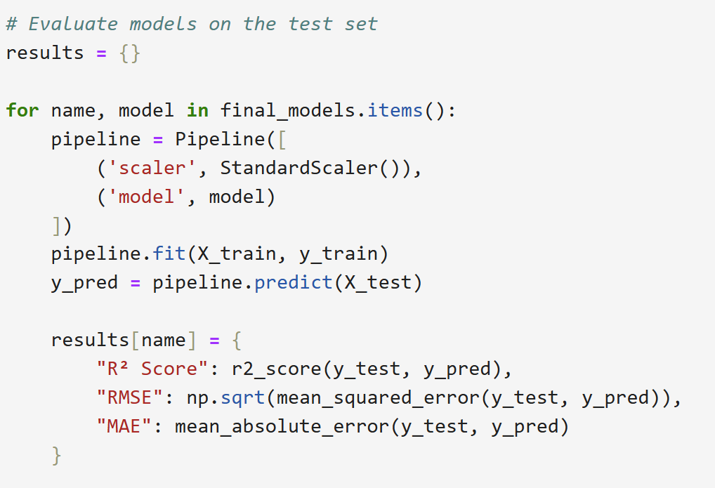
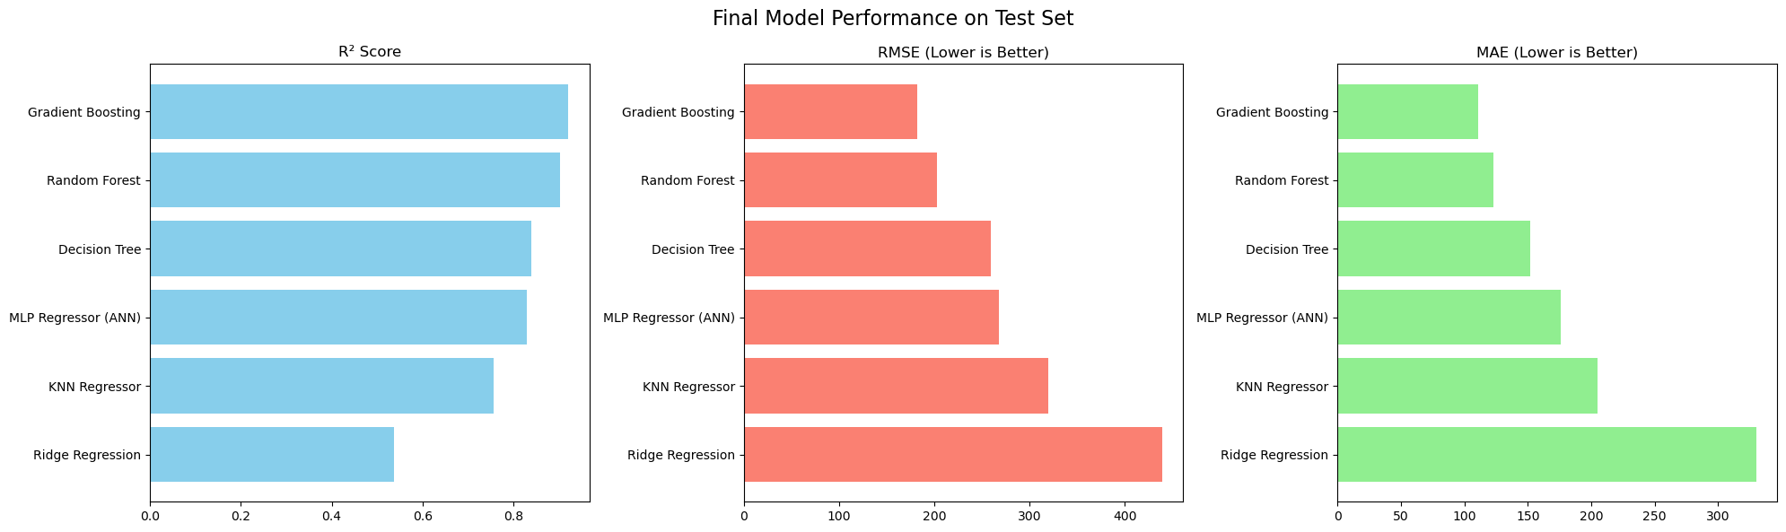
Final Check
Final evaluation on unseen test data confirmed performance:
Gradient Boosting R²: 0.92
Low error metrics
No data leakage: all features showed logical correlations only
This confirms the model is accurate, generalizable, and ready for real-world use.

Slide 27
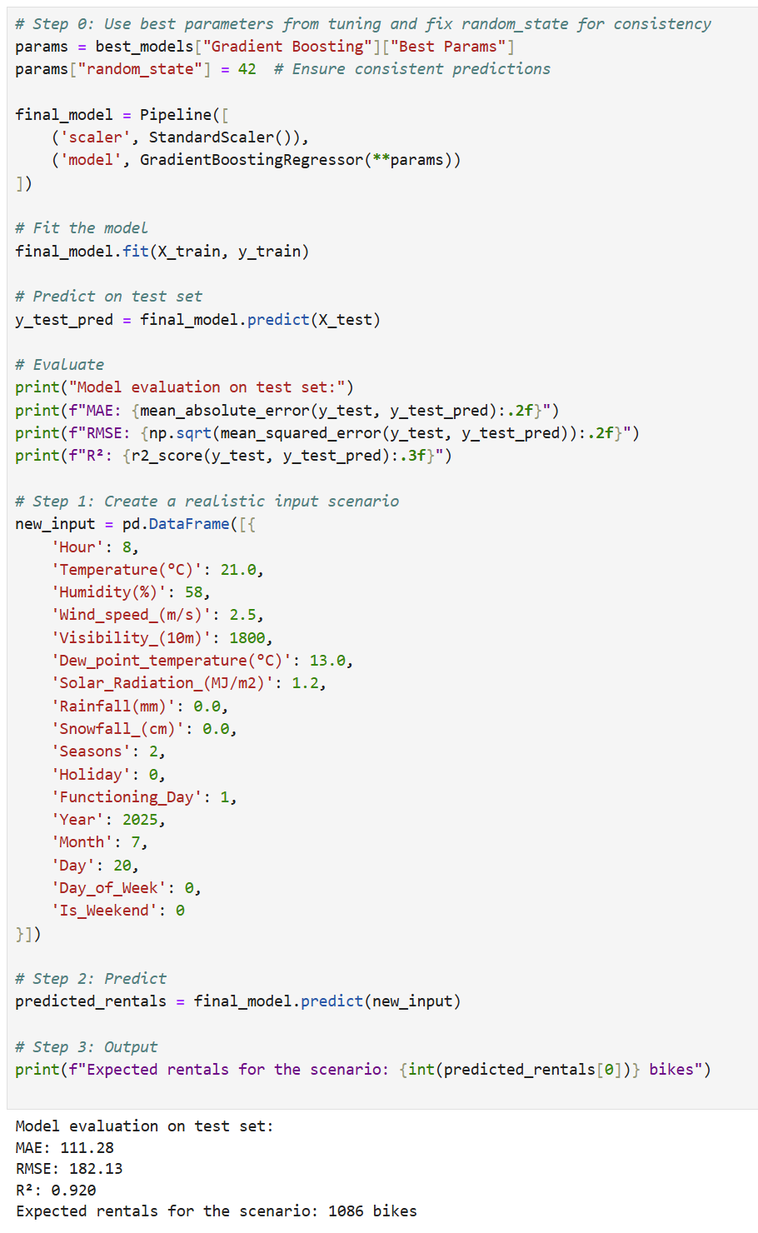
Real Prediction Example
After full training, I tested the model on a realistic input to simulate a deployment scenario:
8 AM on a weekday in July, with 21°C, clear skies, and normal conditions.
Predicted demand: 1086 bikes.
This result matches real-world expectations for weekday commuting behavior in warm, dry weather.

Slide 28
Final Reflection
What began as a modeling task became a story of behavior and routine.
Key observations:
Commuting drives demand: Clear morning/evening peaks
Weather matters: People ride more in warm, dry conditions
Holidays suppress usage: Routine is disrupted
By choosing regression over classification, the model provides actionable, specific predictions – not just “high” or “low” labels.
This project blends:
Data analysis
Real-world behavior
Practical, usable output

Slide 29
Challenges
Improper Validation Initially used only a train-test split; learned the need for a train-validation-test split (64-16-20) to avoid overfitting.
Data Leakage During Scaling Scaled features before splitting, which leaked test data info into training. Fixed by scaling only the training set and transforming validation/test sets afterward.
No Baseline Model at First Skipped Dummy Regressor initially; later realized its importance in setting a performance benchmark.
Unscaled Data in Cross-Validation Poor performance of KNN/MLP models until I began using scaled features during cross-validation.
Overuse of Default Hyperparameters Early models used default settings. Implementing GridSearchCV revealed significant improvements, especially in Gradient Boosting.
Confusion in Model Failures Couldn’t explain why some models failed — started using learning curves to detect overfitting and underfitting.
Accidental Test Set Leakage Used the test set during tuning stages — learned to reserve it strictly for final evaluation only.

Slide 30
Lessons Learned
Importance of Clean Pipelines Small changes like correct scaling order made a big difference in model reliability.
Evaluation Beyond Metrics RMSE/MAE were helpful, but residual plots revealed hidden model issues like skew or bias.
Visual Insights Were Powerful Learning curves and residual plots deepened my understanding of model behavior.
Model Selection = Interpretation + Performance Feature importance helped me see which inputs mattered and justified modeling choices.
Efficiency in Tuning GridSearchCV taught me to balance performance gains with computational cost using manageable parameter grids.
Real-World Relevance Applying my best model (Gradient Boosting) to a realistic scenario showed how models can support real decisions.
Mindset Shift Moved from "just build a model" to thinking like a data scientist — planning, validating, and reflecting at each step.

Slide 31

References
“Examples.” Scikit-learn, scikit-learn.org/stable/auto_examples/index.html.
Using Matplotlib — Matplotlib 3.10.3 Documentation. matplotlib.org/stable/users/index.html.
W3Schools.com. www.w3schools.com/python/default.asp.
Seaborn: Statistical Data Visualization — Seaborn 0.13.2 Documentation. seaborn.pydata.org.
GeeksforGeeks. “Machine Learning Tutorial.” GeeksforGeeks, 3 May 2025, www.geeksforgeeks.org/machine-learning.

Slide 32

Thank You

